Slide 1
Face Mask Detection
ML Project Group Number-18
Deepak Kr. Yadav (1801048)
Utkarsh Mishra (1801191)
Sanchit Kumar (1801155)
Amar Kumar (1801016)
Saksham Tomar (1801150)
Dwarka (1801061)

Slide 2
Contents
Introduction
Problem statement
CNN
Proposed Model
Parameters Explanation
Dataset
Experimental Analysis
Graph
Limitation of the ML Model
Conclusion
Contribution

Slide 3
Introduction
Digital Sector playing crucial role in transforming health sector.
Face Mask Detection is used for detecting covid-19 mask in images.
We have used different approaches for training our model on kaggle dataset - https://www.kaggle.com/andrewmvd/face-mask-detection
Different approaches are CNN-SGD, MLP, SVM and Random Forest algorithm.
We use deep learning CNN for image classification.
Utkarsh Mishra

Slide 4
Problem Statement
We have to predict whether a person is wearing a face mask or not and also find the best algorithm which has highest accuracy for our given kaggle dataset.

Slide 5
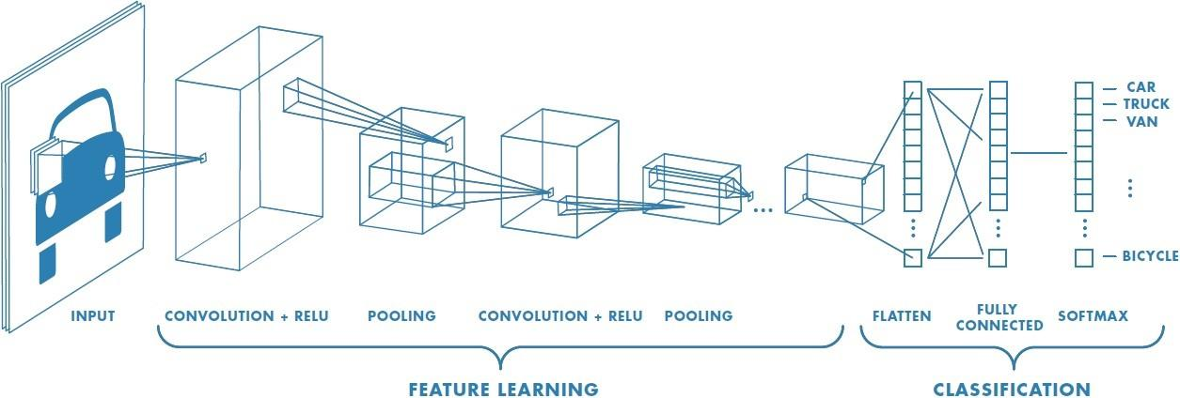
Convolutional Neural Networks
In neural networks, Convolutional neural network (ConvNets or CNNs) is one of the main categories to do images recognition, images classifications.
CNN image classifications takes an input image, process it and classify it under certain categories .
Deep learning CNN models to train and test, each input image will pass it through a series of convolution layers with filters (Kernels), Pooling, fully connected layers (FC) and apply Softmax function to classify an object with probabilistic values between 0 and 1.

Slide 6
CNNs have an input layer, and output layer, and hidden layers. The hidden layer susually consist of convolutional layers, ReLU layers, pooling layers, and fully connected layers.
Convolutional layers apply a convolution operation to the input. This passes the information on to the next layer.
Pooling combines the outputs of clusters of neurons into a single neuron in the next layer.
Fully connected layers connect every neuron in one layer to every neuron in the next layer.

Slide 7
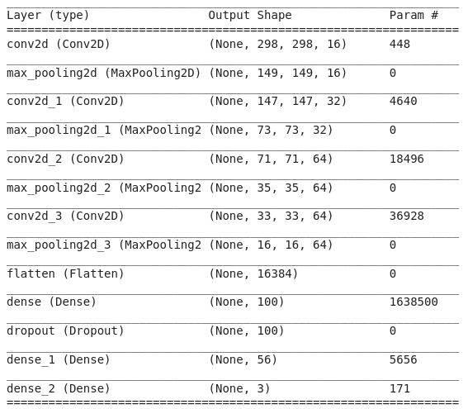
Proposed Solution Architecture
Total params: 1,704,839
Trainable params: 1,704,839
Non-trainable params: 0

Slide 8
Parameters Explanation
Input Layer:Input layer has nothing to learn so no learnable parameter. Thus parameter =0
m=width , n=height , d=previous layer’s filter , k=number of filter
CONV layer: ((m*n*d)+1*k)
POOL Layer: No learnable parameter as all it does is calculate a specific number. So number of parameter =0
C = current layer neurons , p = previous layer neurons
Fully Connected Layer: (C*(p+1))

Slide 9
Dataset
We have dataset from kaggle in which 853 images are present.The 853 images belonging to 3 classes.
These classes are
1.With_mask
2.Without_mask
3.Mask worn incorrectly.

Slide 10
Experimental Analysis
We have compared our approach to other approaches on the same dataset and the result as follows :
MODEL | Accuracy(approx)
Multilayer Perceptron | 93.86%
SVM | 93.6196%
Random Forest | 93.9877%
CNN | 94.3%

Slide 11
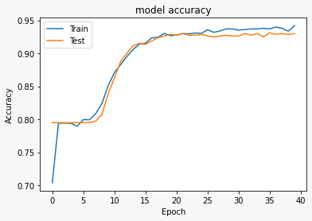
Graph

Slide 12
Limitation of the ML Model
MLP, SVM and Random Forest algorithm is not feasible for higher pixels values.
CNN is bit slow while Running Code.

Slide 13
Conclusion
This deep learning model to detect if a person is wearing a mask or not. The aim of this work is to ensure the use of mask to stop the spread of deadly Coronavirus . The model contains a face detection algorithm using a Convolution Neural Network which detects face mask with an accuracy of 94.3%. The proposed model will help to identify people not wearing mask and ensure safety from COVID-19
Amar Kumar

Slide 14
Contribution
Amar Kumar- Code Implementation,Slide Making,Research Paper Reading
Deepak Kumar Yadav - Report Making, Research Paper Reading, Slide Making,Helped in Code Implementation
Dwarka Prasad Bairwa: Architecture Proposed
Saksham Tomar : Research ,Slide Making,Report Making ,Literature Reading.
Sanchit Kumar: Code Implementation , Slide Making , Result Analysis in Report, Literature Reading
Utkarsh Mishra: Research, Report making,Literature Reading, slide making.

Slide 15
Thank You

